Slide 1

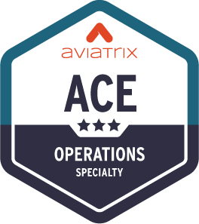
Network Segmentation
ACE Solutions Architecture Team

Slide 2
Network Segmentation - Overview
When you identify groups of spoke and edge VPC/VNets in your infrastructure with the same requirements from a networking point of view (network reachability), you may want to group them in what Aviatrix calls “network domains”.
A network domain is an Aviatrix enforced network of one or more spoke VPC/VCN/VNets.
The key use case for building network domains is to segment traffic for an enhanced security posture. You use them, in conjunction with connection policies, to achieve the network isolation for inter-VPC/VNC/VNets connectivity that you want for your network.
Implementing Network Segmentation in an Aviatrix-Managed Network (official documentation link):
https://docs.aviatrix.com/copilot/latest/network-security/network-segmentation-secured.html?expand=true
2

Slide 3









MCNA Deployment: the Foundations
APPLICATIONS LAYER
CORE
LAYER
Spoke VPC 1
Spoke VPC 2
Spoke VNet 1
Spoke VNet 2
Spoke VPC 1
Spoke VPC 2
TRANSIT LAYER
Transit VNet
Transit VPC
Transit VPC
OPERATIONS
ACCESS LAYER
BRANCH
OFFICES
ON-PREM
DATA CENTER
Vendors/Partners
REMOTE
USER
INTERNET
IoT
AWS
Azure
GCP

Slide 4
Global Segmentation with Network Domains
APPLICATIONS LAYER
CORE
LAYER
Spoke VPC 1
Spoke VPC 2
Spoke VNet 1
Spoke VNet 2
Spoke VPC 1
Spoke VPC 2
Transit VNet
TRANSIT LAYER
Transit VPC
Transit VPC
OPERATIONS
ACCESS LAYER
BRANCH
OFFICES
ON-PREM
DATA CENTER
Vendors/Partners
REMOTE
USER
INTERNET
IoT
AWS
Azure
GCP

Slide 5

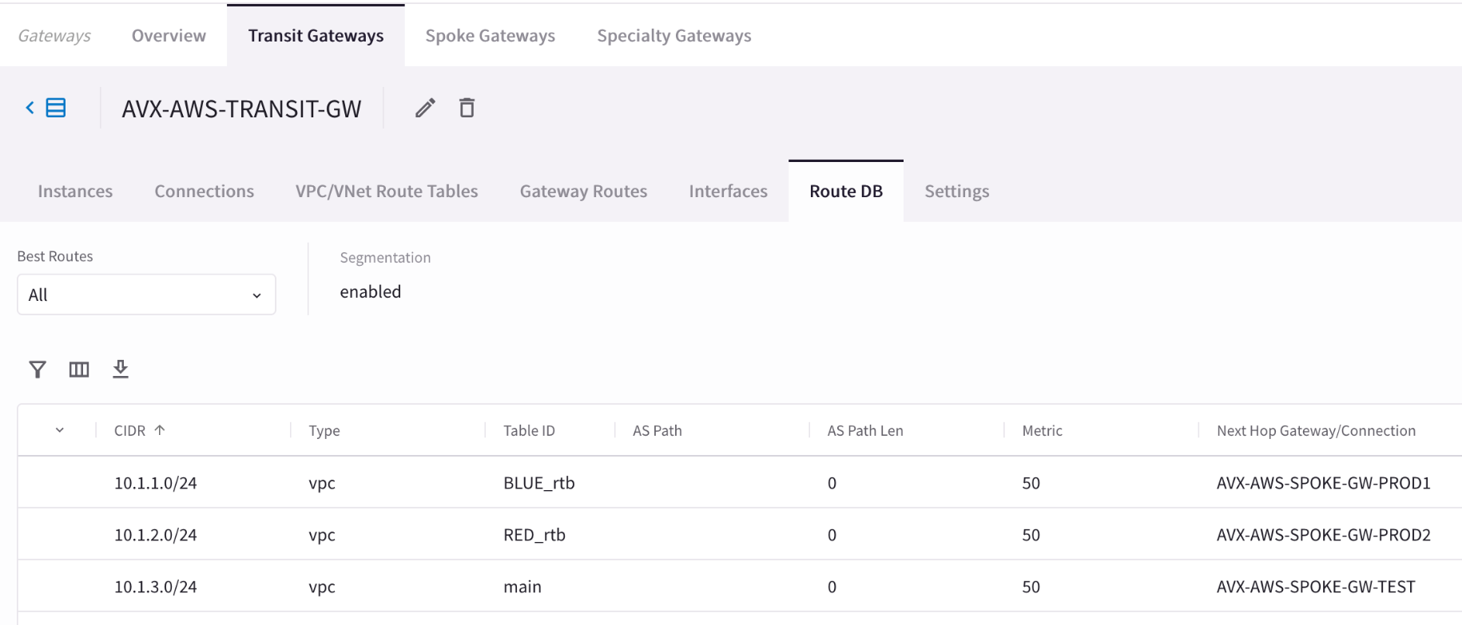

Order of Operations for activating the Network Segmentation
Enable Network Segmentation on the relevant Transit Gateway(s)
Create Network Domains (aka Segments)
Associate Spoke Gateways and/or Site2Cloud connections to the Network Domains
Apply the Connection Policy (optional)
Spoke PROD1
Spoke PROD2
Spoke TEST
10.1.1.0/24
10.1.2.0/24
10.1.3.0/24
Transit VPC
PATH: COPILOT > Cloud Fabric > Gateways > Transit Gateways > select the relevant GW > Route DB (equivalent of RIB)

Slide 6
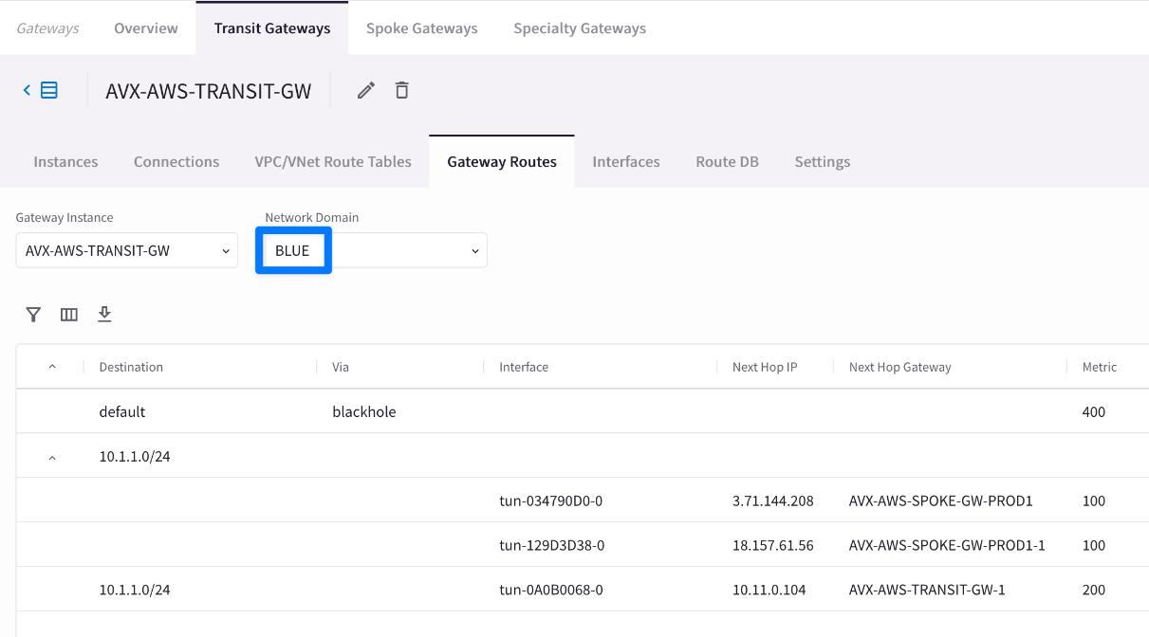
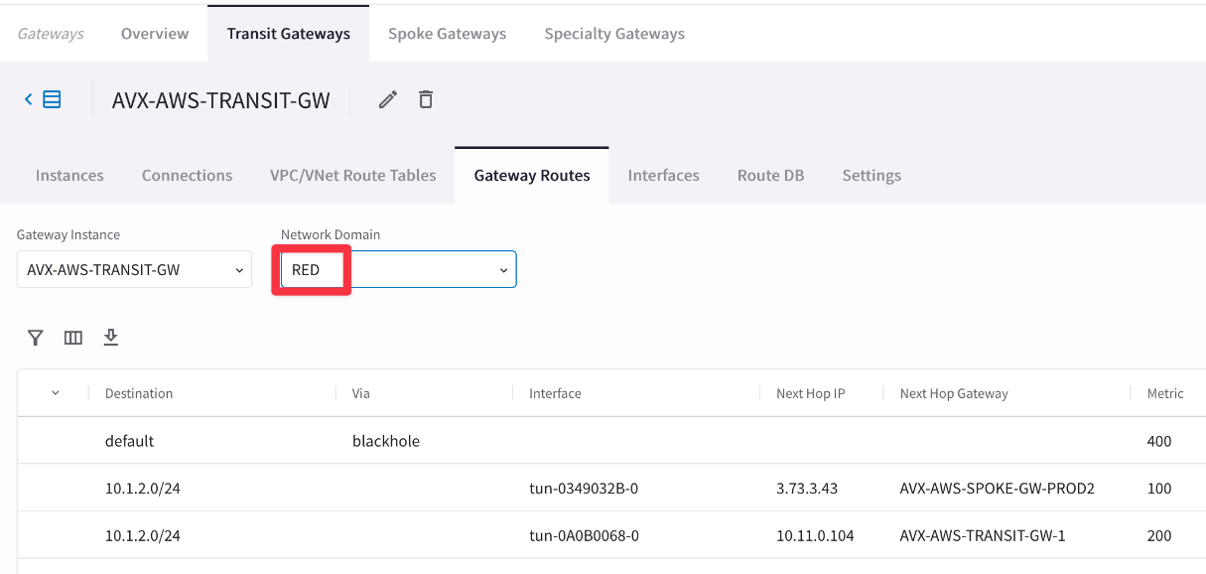
Multiple Routing Domains on the Transit GW
Spoke VPC 1
Spoke VPC 2
Spoke VPC 3
10.1.1.0/24
10.1.2.0/24
10.1.3.0/24
Transit VPC
A single Spoke gateway or a Cluster of Spoke Gateways can be associated to a unique domain!
PATH: COPILOT > Cloud Fabric > Gateways > Transit Gateways > select the relevant GW > Gateway Routes and then filter based on the network domain (i.e. VRF)
CAVEAT: The specific Network Domain view (aka vrf) is only available on the Transit GW. The Spoke GW has only the main routing table (aka grt).

Slide 7



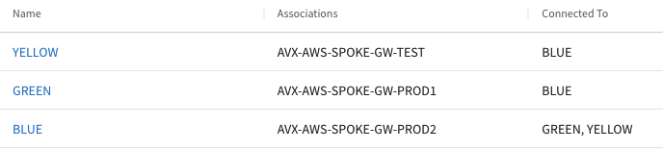
Connection Policy
The Connection policy allows the inter-domain communication or inter-segment communication (is akin to the vrf leaking from the MPLS technology).
The connection policy establishes a bidirectional connectivity (merging the network domains’ RTBs).
In the example on the right, there are three domains:
Green
Blue
Yellow
If the Blue domain acts as the Shared Services Domain, It will be connected to both the GREEN domain and the YELLOW domain.
Spoke VPC 1
Spoke VPC 2
Spoke VPC 3
10.1.1.0/24
10.1.2.0/24
10.1.3.0/24
Transit VPC
CAVEAT: a connection policy can’t be applied on the main RTB (aka Global Routing Table).

Slide 8
Tools for Operating Network Segmentation

Slide 9
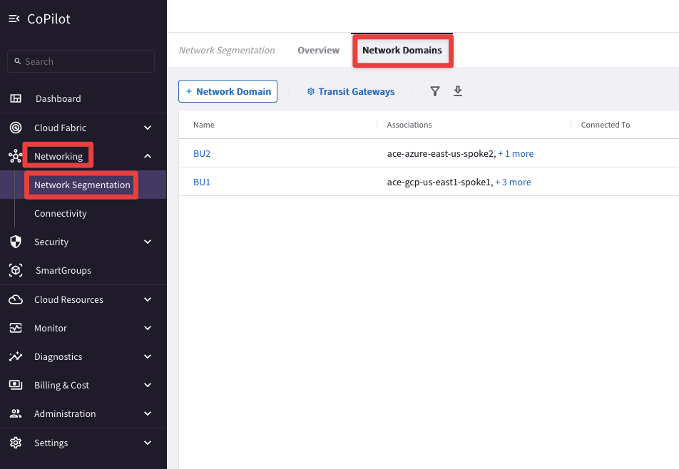
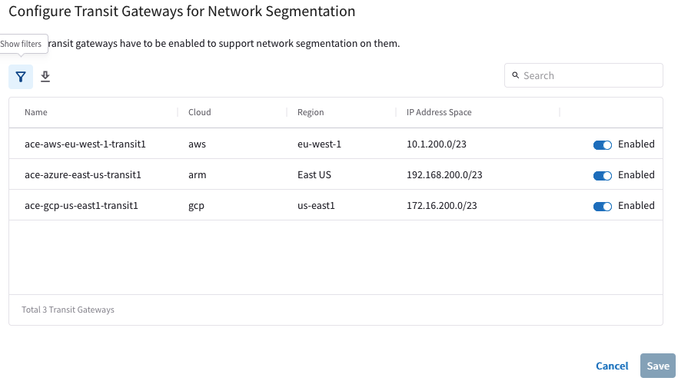
Network Segmentation Visibility
CoPilot: verify the Network Domains
PATH: COPILOT > Networking > Network Segmentation > Network Domains

Slide 10
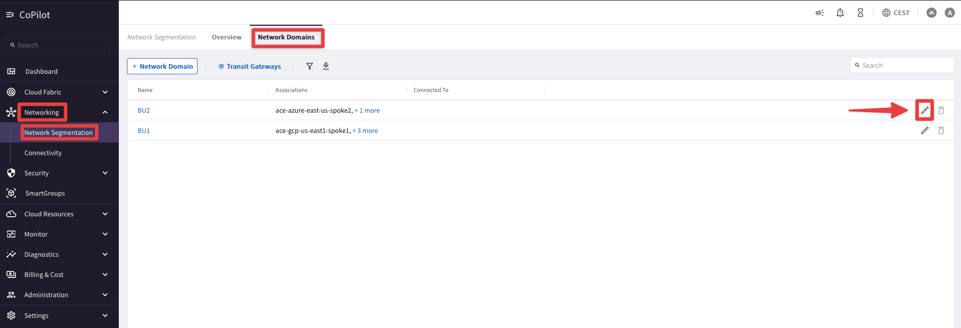
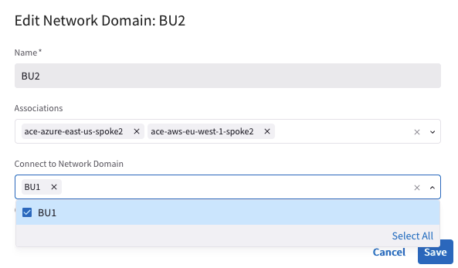
Network Segmentation Visibility
CoPilot: create/modify the Network Domains
PATH: COPILOT > Networking> Network Segmentation > Network Domains > pencil icon (edit)

Slide 11
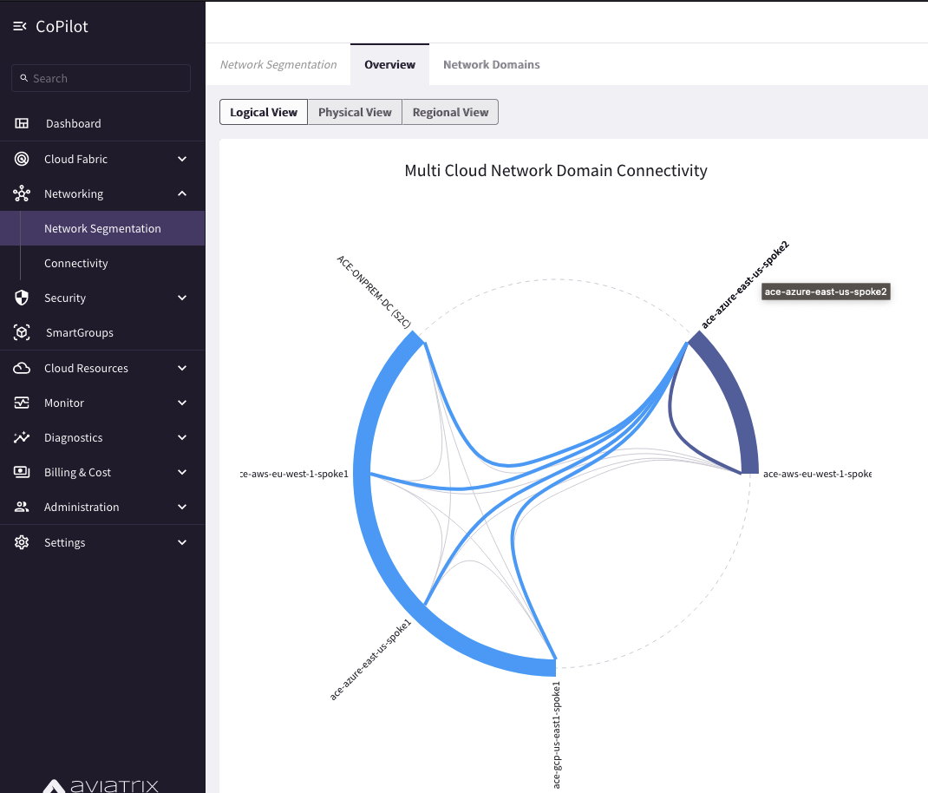
Network Segmentation Visibility
CoPilot: verify the Network Relationships
PATH: COPILOT > Networking > Network Segmentation > Overview > Logical View

Slide 12
Next: Lab 1 Network Domains & Lab 2 Connection Policy

